Slide 1
Domaille Engineering APM-HDC-5400 10” Screen
Update Domaille Software
In your APM-HDC-5400 10” Screen

Slide 2
Beginning Step Determination
In order to perform a software upgrade, a USB with the appropriate upgrade file is necessary.
If you already have your USB with the correct software on it then you can skip to Step 7.
If not, begin the process to download your software on Step 1.

Slide 3
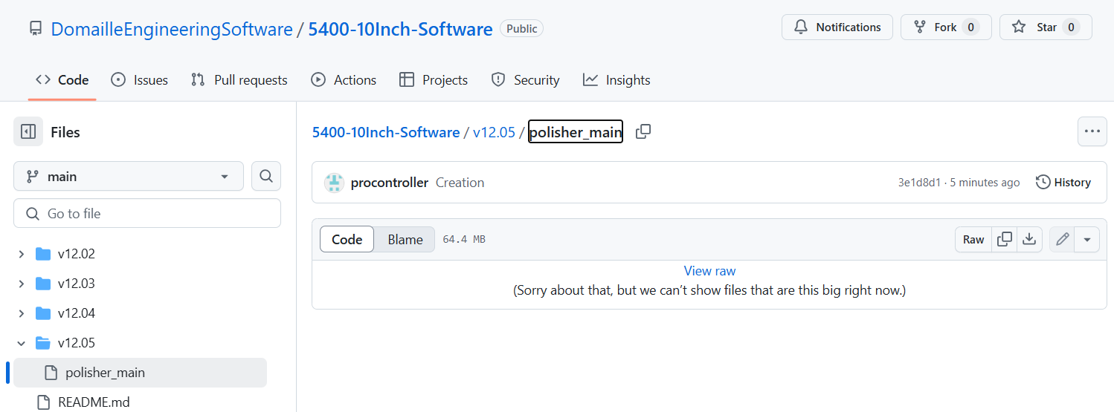
Step 1
Navigate to: https://github.com/DomailleEngineeringSoftware/5400-10Inch-Software

Slide 4
Step 2
Select the folder for the version of software you want. In this example, we’ll use v12.05

Slide 5
Step 3
Select the file “polisher_main”

Slide 6
Step 4
Click the download button

Slide 7
Step 5
Insert the USB into your system, create a folder in the root directory of the USB and name it “Upgrade”.

Slide 8
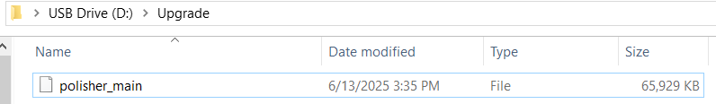
Step 6
Within this folder, add the downloaded “polisher_main” from your downloads folder.
The USB is now prepared for the polisher.
***It is important to note that the folder must be named “Upgrade” and the file must be named “polisher_main”, else the upgrade procedure will fail.***

Slide 9
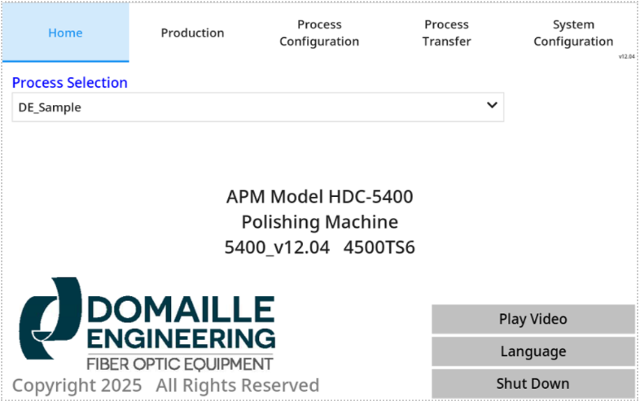
Step 7
Navigate to the Home Screen. Clear all notification, warning or alarm windows. Hold the bottom-left corner of the screen for 5 seconds.

Slide 10
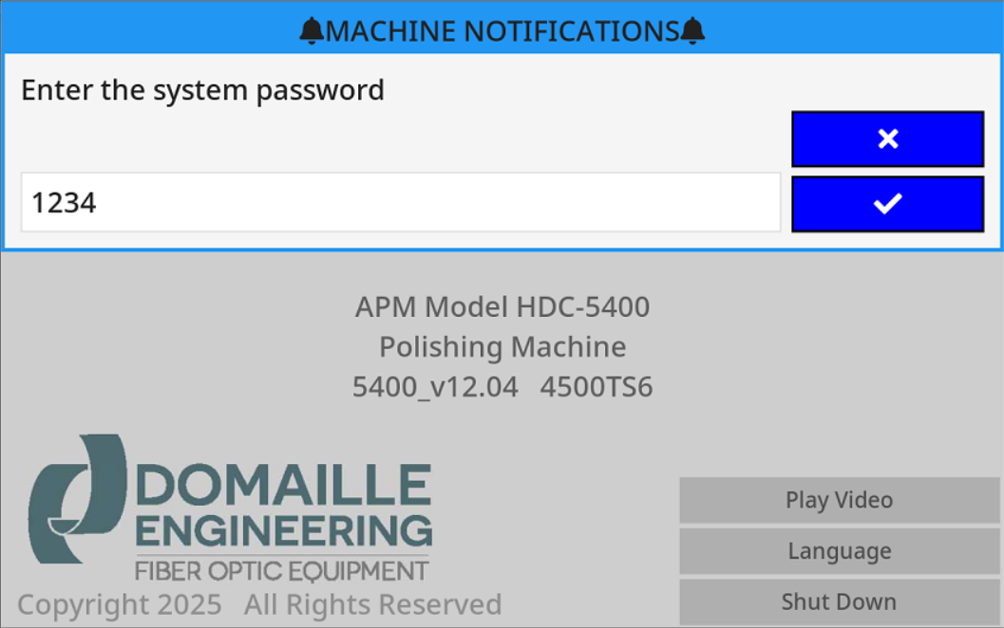
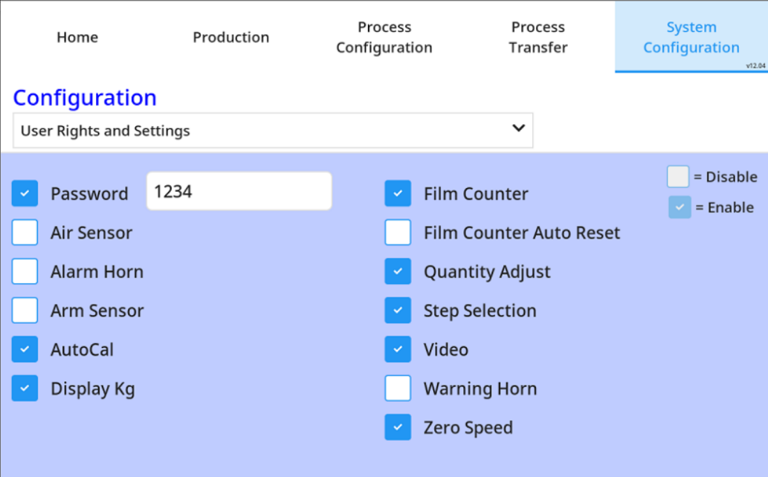
Step 8
A window prompt will pop up for entering the password.
Enter the password and select the “check mark” button.
NOTE: the password you enter will be the same as what’s listed in the User Rights and Settings drop down on the System Config tab (even if this password is not enabled on that page). If none has been entered, the default is 1234.

Slide 11
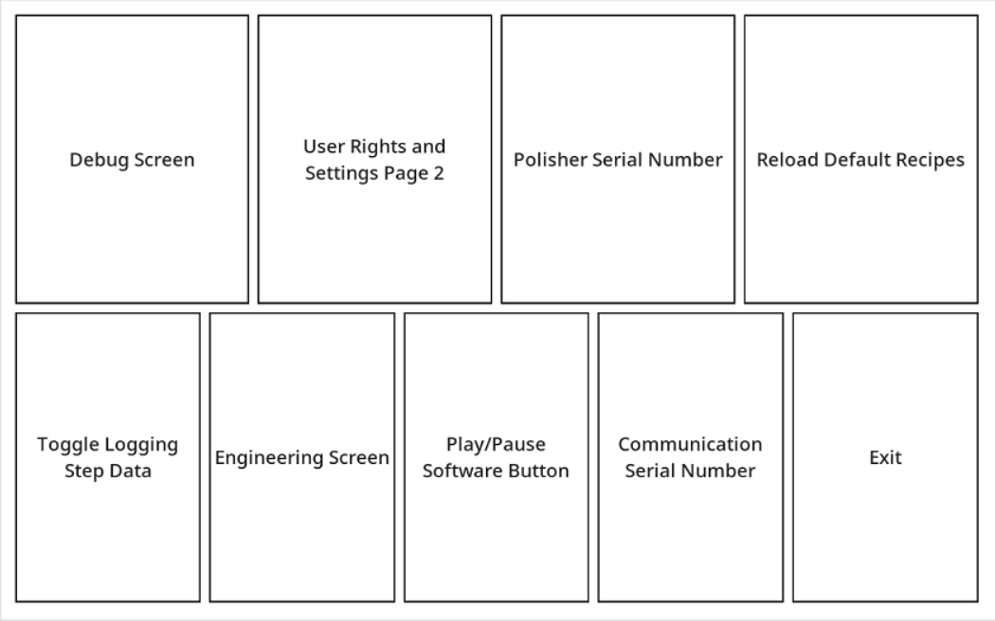
Step 9
Select the “Debug Screen” button.

Slide 12
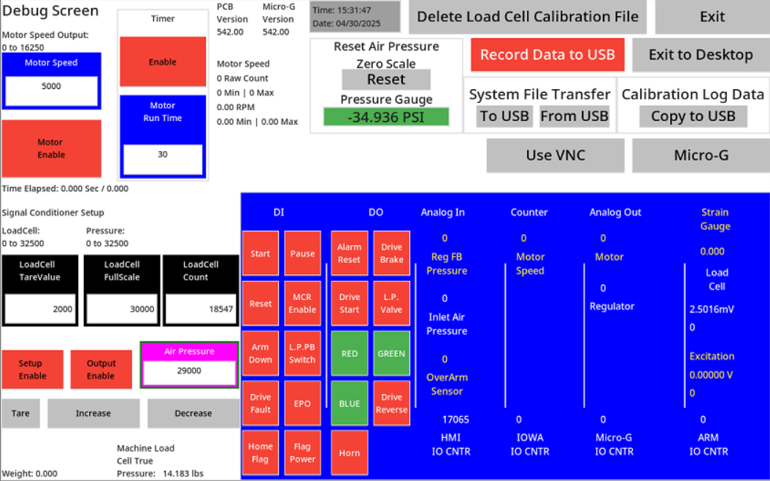
Step 10
Select the “Exit to Desktop” button

Slide 13
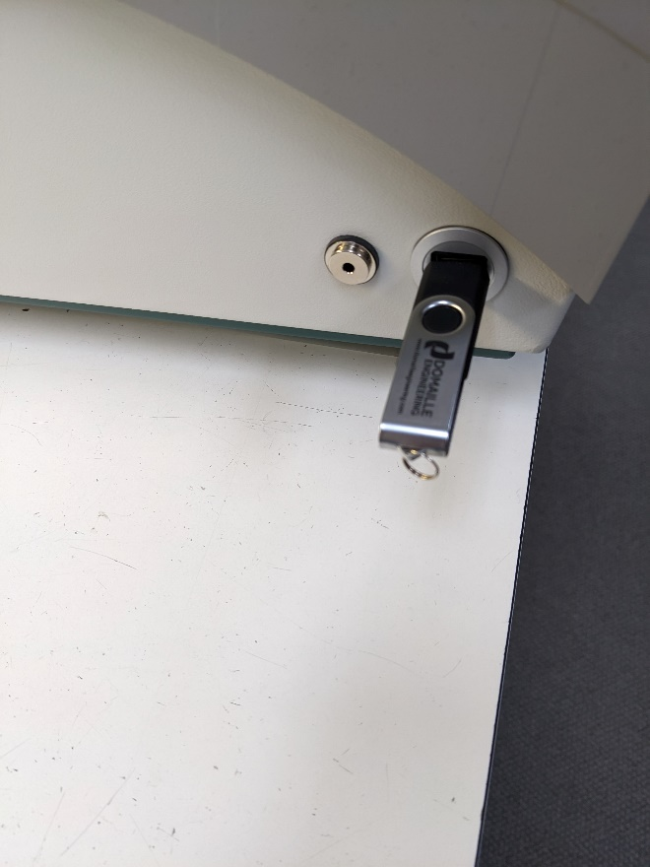
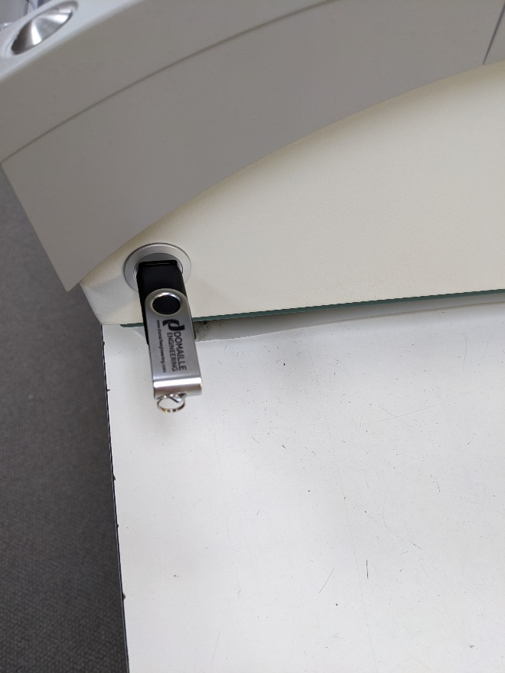
Step 11
Plug in the USB containing the appropriate Domaille upgrade file on it into either left or right USB ports on the side of machine.

Slide 14

Step 12
Wait 5 seconds for the USB to be automounted.

Slide 15

Step 13
Single click the Domaille Logo icon on the top-left of the screen.
DO NOT DOUBLE CLICK!

Slide 16

Step 14
After a few seconds, a prompt will pop up to overwrite the application. Hit Yes.
***NOTE: IF THE PROMPT DOESN’T COME UP, THEN THE “polisher_main” FILE WASN’T FOUND IN THE “Upgrade” FOLDER INDSIDE THE ROOT DIRECTORY OF THE USB AND YOU WILL NEED TO START BACK FROM STEP 1.***

Slide 17
Step 15
After about 10 seconds, the upgrade will be completed, and the application will AutoStart and reload the Home Screen.

Slide 18
Step 16
Remember to remove your USB Stick from the port.
Process Completed.

